Slide 1
TikTok
Finn Fitzgerald I Savannah Thompson
Notes:
Holding screen

Slide 2
Introduction
Purpose
The purpose of this presentation is for the Ace Conference attendees to understand
What TikTok is
How to use it, tips & tricks, creation process, editing process
How it can benefit your organization
Derbyshire Community Banks journey & experiences
Notes:
DH

Slide 3
What is TikTok?
TikTok is a social media platform for creating, sharing and discovering short videos. The app is used by young people as an outlet to express themselves through a variety of creative ways, TikTok users create videos and share them across a world wide community.
Notes:
DH

Slide 4
Creating Content
How to create content – Canva Design & CapCut Editing
How we manage it (Zoho Social, schedule, etc.)
What content works?
When – Best time of day? Week? Time of Year
Who actually watches and responds to our TikTok?
Notes:
AJ

Slide 5
Creating Content
Content Tips
Memes
Seasonal Events
Daily posts (Friday feeling, Monday blues, excited about upcoming events)
Promote services & products with humorous memes
Relatable content to young people
Stay relevant with news & trends (Community events too)
Notes:
AJ

Slide 6
Creating a TikTok Campaign
Campaign Name (What is the purpose of the campaign?) Loans, Savings, website promotion? Online Banking, or just entertaining content?
Search for examples on social media as influence
What outcome do you want from campaign? More Likes, followers, new members, brand awareness?
Use surveys to help with member feedback & data
Notes:
AJ

Slide 7
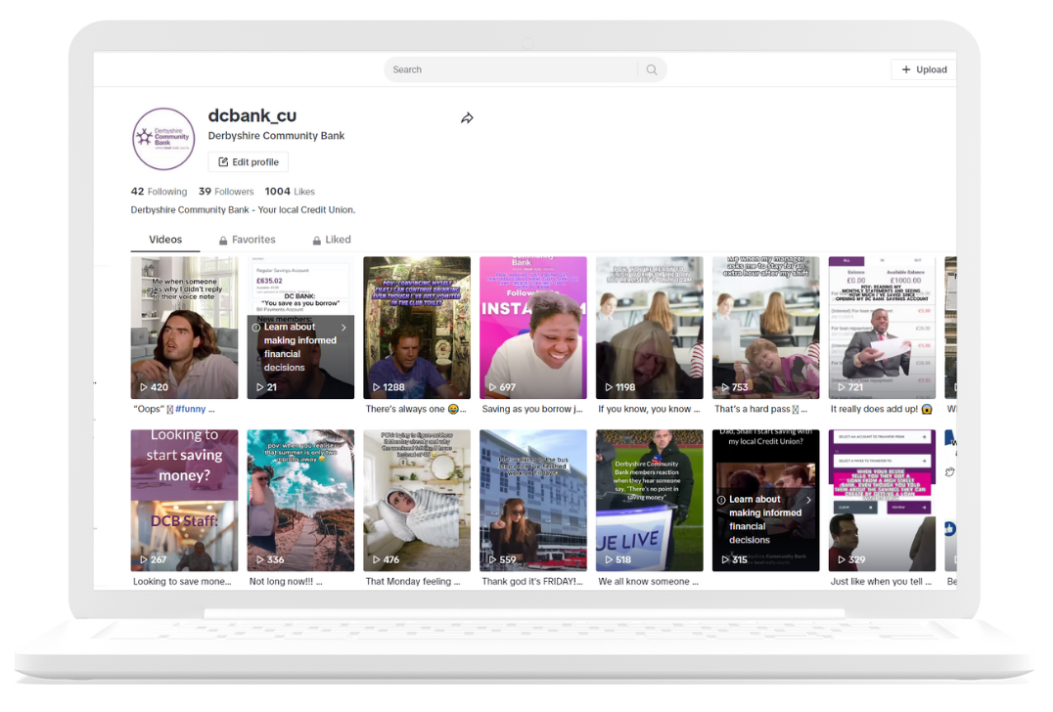
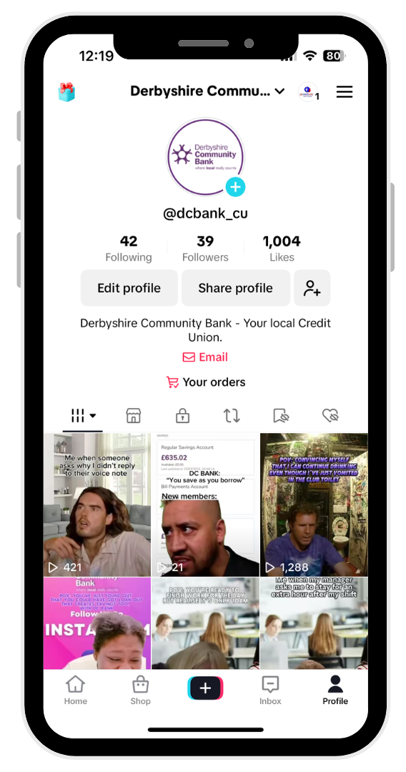
Our Examples & Journey
https://www.tiktok.com/@dcbank_cu
Notes:
AJ

Slide 8
Warnings & Challenges
Time commitment
Creative Ideas
Consistency
Education
Knowing the balance of informative messaging & entertainment
Original content
Notes:
AJ

Slide 9
Analytics
(To be added closer to presentation)
Notes:
AJ

Slide 10
Conclusion
Today's Aim
What is our end goal? What do we want out of TikTok?

Slide 11
Questions?
Email us for PowerPoint content or if you have an questions.
Finn Fitzgerald – f.fitzgerald@dcbank.org.uk
Savannah Thompson s.thompson@dcbank.org.uk

Slide 12
Useful URL’s
CU Insight Article - https://www.cuinsight.com/hey-credit-union-marketers-its-time-to-talk-tiktok/
TikTok for Business - https://zurl.co/kb4V
Creating an account - https://zurl.co/nWb9
Derbyshire Community Bank TikTok Feed on website - https://www.dcbank.org.uk/2024/04/derbyshire-community-bank-are-on-tiktok/
Notes:
AJ

